Slide 1
Configuration Model Properties
MA 653: Network Science
Instructor: Ashok Singh Sairam
ashok@iitg.ac.in

Slide 2
Excess Degree Distribution
Consider a configuration model with degree distribution p_{k}
Means a fraction of the nodes p_{k} have degree k
But suppose we chose a node (randomly or otherwise) and follow one of its edges. What is the probability that the node will have degree k?

Slide 3
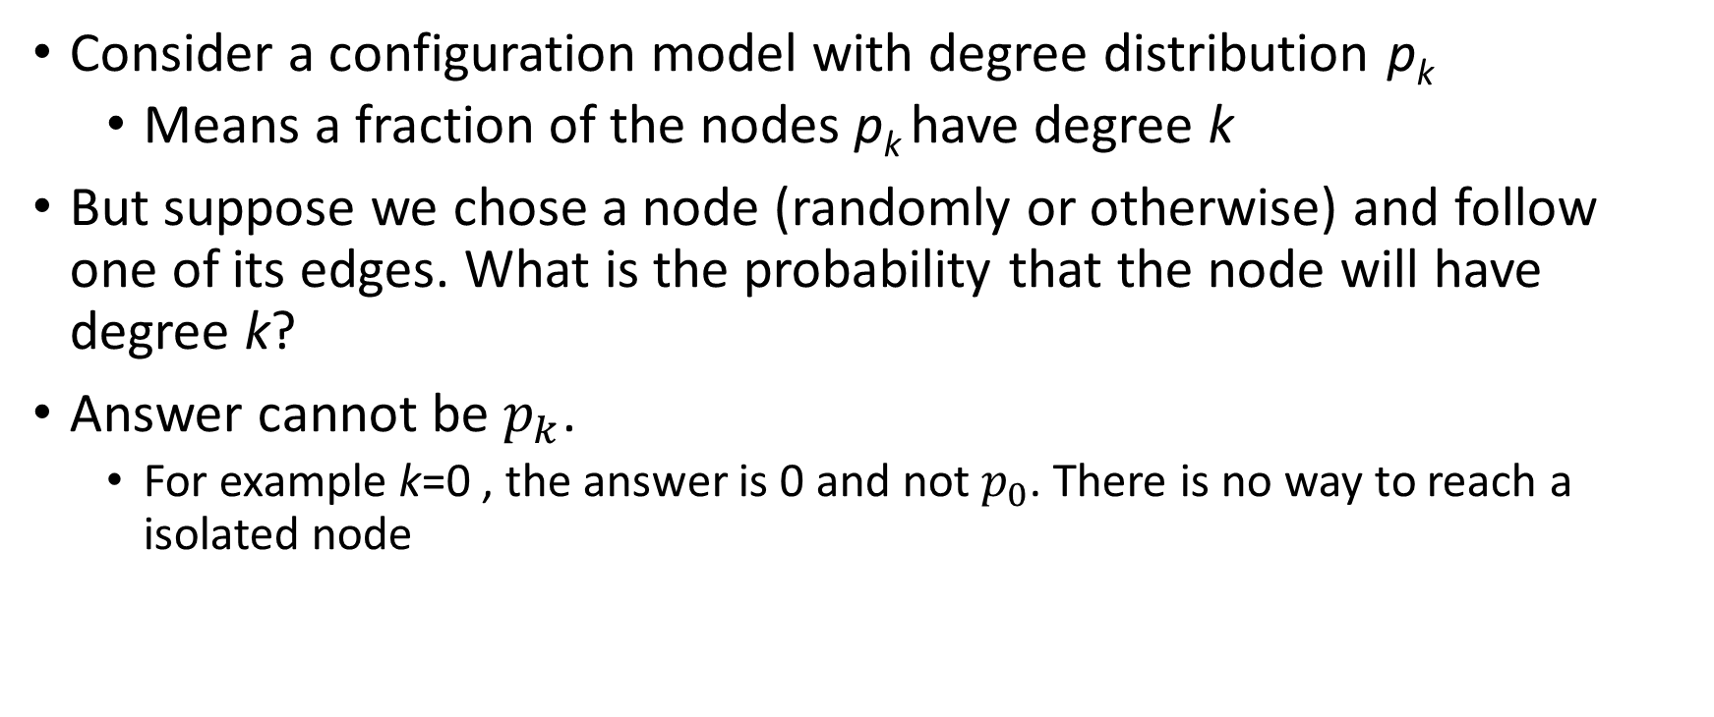
Excess Degree Distribution (2)
Consider a configuration model with degree distribution p_{k}
Means a fraction of the nodes p_{k} have degree k
But suppose we chose a node (randomly or otherwise) and follow one of its edges. What is the probability that the node will have degree k?
Answer cannot be $p_{k}$.
For example k=0 , the answer is 0 and not $p_{0}$. There is no way to reach a isolated node

Slide 4
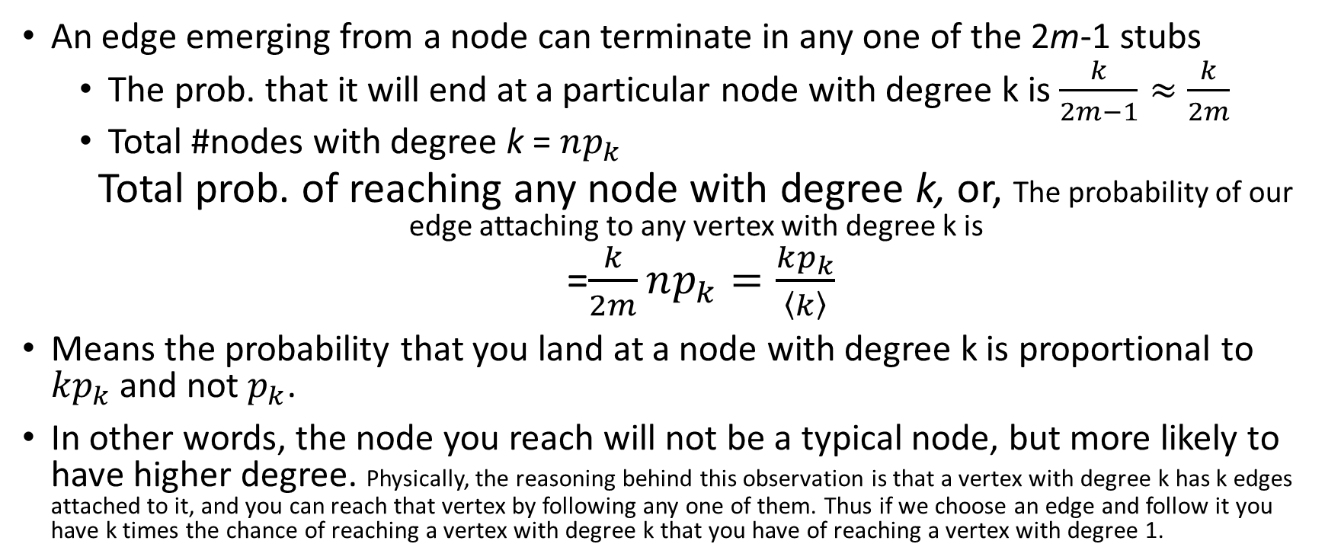
Excess Degree Distribution(3)
An edge emerging from a node can terminate in any one of the 2m-1 stubs
The prob. that it will end at a particular node with degree k is $\frac{k}{2m−1}≈\frac{k}{2m}$
Total #nodes with degree k = $np_{k}$
Total prob. of reaching any node with degree k, or, The probability of our edge attaching to any vertex with degree k is
=$\frac{k}{2m}np_{k}=\frac{kp_{k}}{\left\langle k\right\rangle }$
Means the probability that you land at a node with degree k is proportional to ${kp}_{k}$ and not $p_{k}$.
In other words, the node you reach will not be a typical node, but more likely to have higher degree. Physically, the reasoning behind this observation is that a vertex with degree k has k edges attached to it, and you can reach that vertex by following any one of them. Thus if we choose an edge and follow it you have k times the chance of reaching a vertex with degree k that you have of reaching a vertex with degree 1.

Slide 5
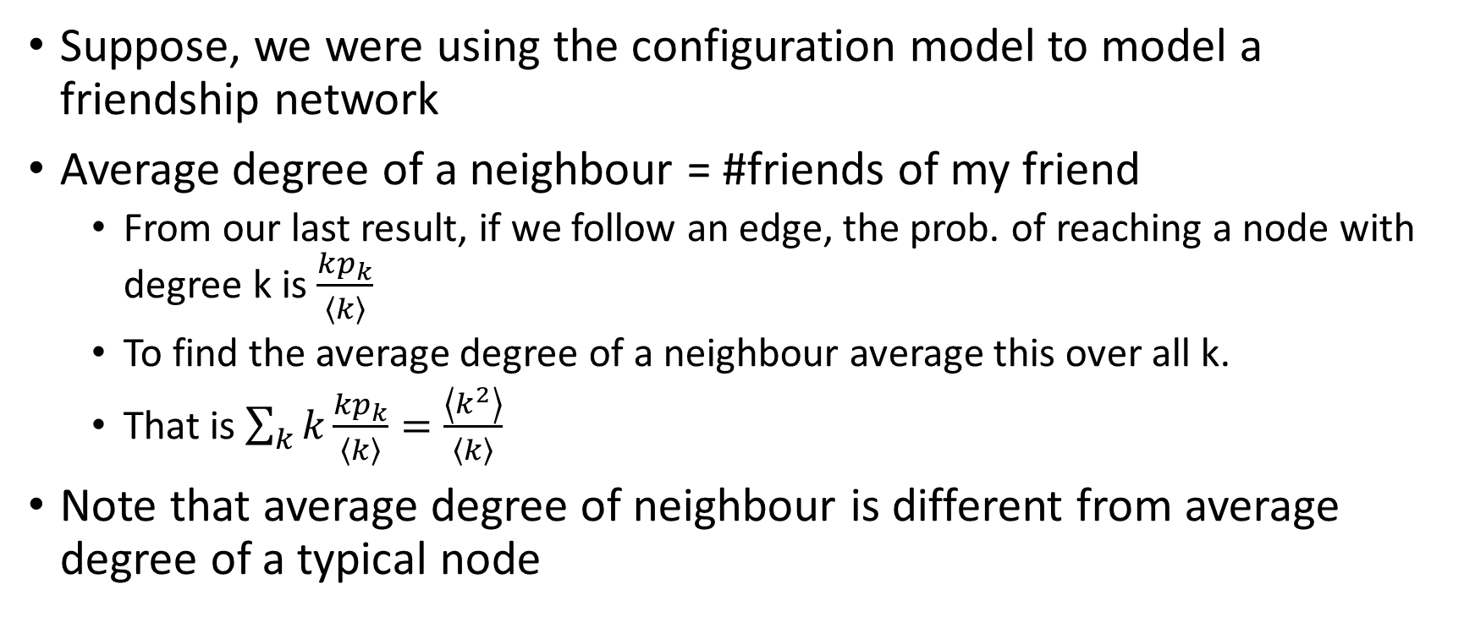
Average degree of a neighbour
Suppose, we were using the configuration model to model a friendship network
Average degree of a neighbour = #friends of my friend
From our last result, if we follow an edge, the prob. of reaching a node with degree k is $\frac{kp_{k}}{\left\langle k\right\rangle }$
To find the average degree of a neighbour average this over all k.
That is $\sum_{k}{k\frac{{kp}_{k}}{\left\langle k\right\rangle }}=\frac{\left\langle k^{2}\right\rangle }{\left\langle k\right\rangle }$
Note that average degree of neighbour is different from average degree of a typical node

Slide 6
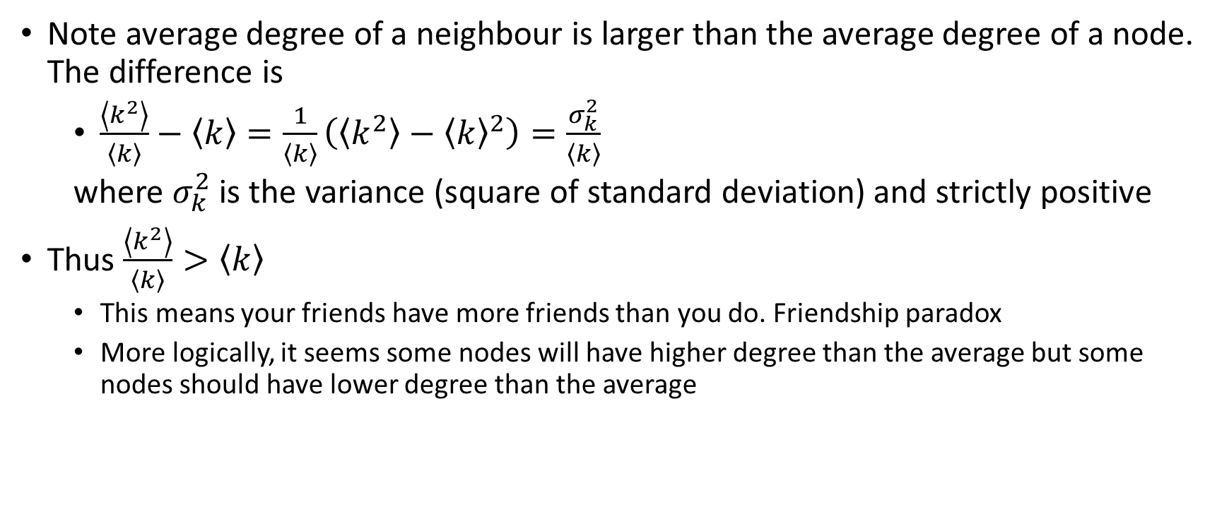
Friendship paradox
Note average degree of a neighbour is larger than the average degree of a node. The difference is
$\frac{\left\langle k^{2}\right\rangle }{\left\langle k\right\rangle }−\left\langle k\right\rangle =\frac{1}{\left\langle k\right\rangle }\left(\left\langle k^{2}\right\rangle −{\left\langle k\right\rangle }^{2}\right)=\frac{σ_{k}^{2}}{\left\langle k\right\rangle }$
where $σ_{k}^{2}$ is the variance (square of standard deviation) and strictly positive
Thus $\frac{\left\langle k^{2}\right\rangle }{\left\langle k\right\rangle }>\left\langle k\right\rangle$
This means your friends have more friends than you do. Friendship paradox
More logically, it seems some nodes will have higher degree than the average but some nodes should have lower degree than the average

Slide 7
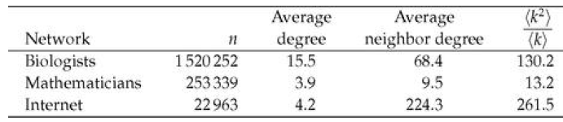
Real-world examples of friendship paradox
The friendship paradox is true for many networks
When you go through the nodes of a networks and average the degree of the neighbours, many of the neighbours will appear in more than one average
A node with degree k will appear in k averages
High degree nodes are over-represented as compared to low-degree ones, which pushes up the overall average

Slide 8
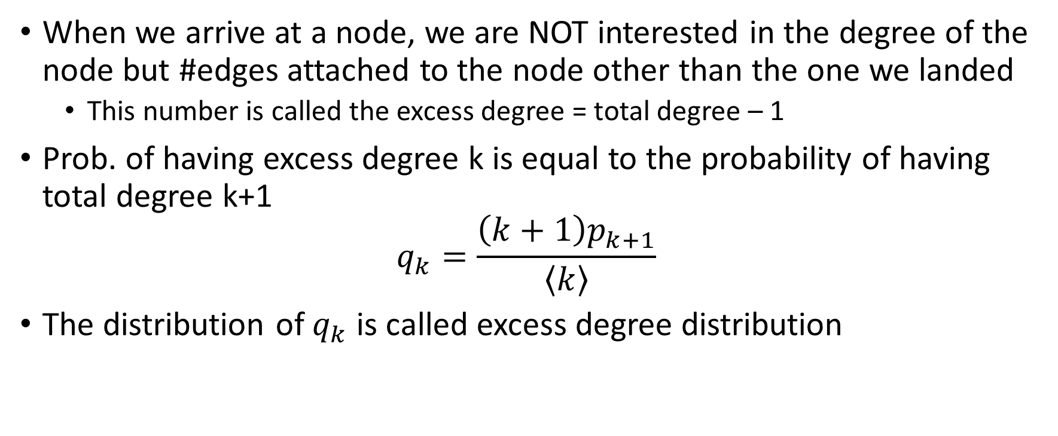
Excess degree
When we arrive at a node, we are NOT interested in the degree of the node but #edges attached to the node other than the one we landed
This number is called the excess degree = total degree – 1
Prob. of having excess degree k is equal to the probability of having total degree k+1
$$q_{k}=\frac{\left(k+1\right)p_{k+1}}{\left\langle k\right\rangle }$$
The distribution of $q_{k}$ is called excess degree distribution

Slide 9
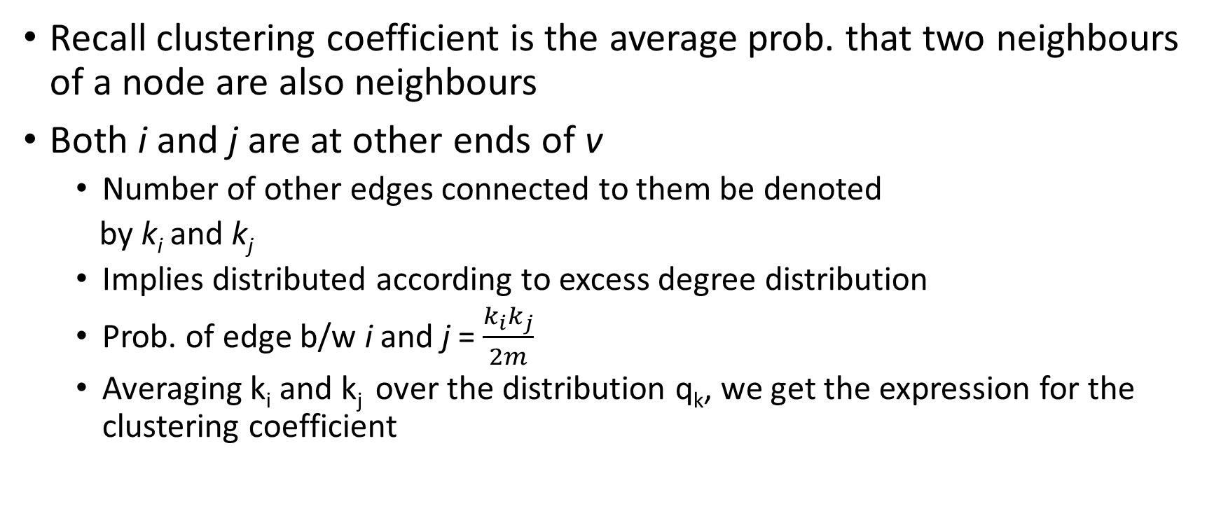
Clustering Coefficient
Recall clustering coefficient is the average prob. that two neighbours of a node are also neighbours
Both i and j are at other ends of v
Number of other edges connected to them be denoted
by k_{i} and k_{j}
Implies distributed according to excess degree distribution
Prob. of edge b/w i and j = $\frac{k_{i}k_{j}}{2m}$
Averaging k_{i} and k_{j} over the distribution q_{k}, we get the expression for the clustering coefficient
i
v
j

Slide 10
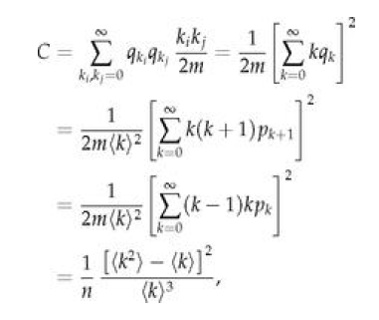
Clustering Cefficient

